Slide 1
Artificial Intelligence and Neurocognitive Technologies for Human Augmentation.
Włodzisław Duch
Neurocognitive Laboratory, Center for Modern Interdisciplinary Technologies, Dept. of Informatics, Faculty of Physics, Astronomy & Informatics,
Nicolaus Copernicus University Google: Wlodzislaw Duch
27-th International Conf. on Transdisciplinary Engineering (TE2020), Warsaw 7/2020

Slide 2
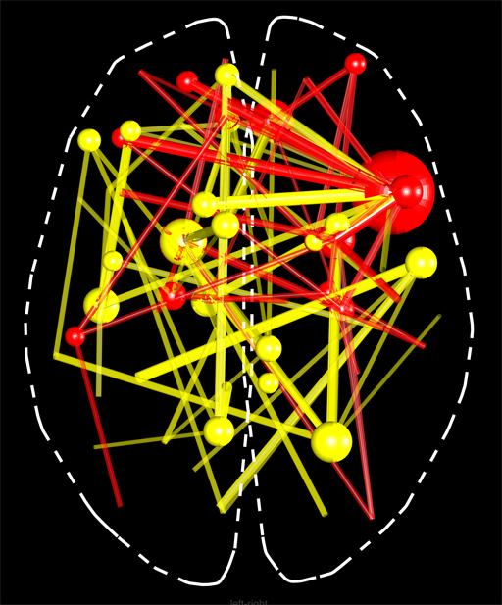
On the threshold of a dream …
How mental states arise from specific activity of the brain networks?
Global brain neurotech initiatives.
Brain networks – space for neurodynamics.
Neurotech for human enhancements.
Fingerprints of Mental Activity.
Dynamic functional brain networks.
Simulation of brain networks.
Final goal: Use your brain to the max! Optimization/enhancement of brain processes?
Duch W (1996) Computational physics of the mind. Computer Physics Communication 97: 136-153
Duch. W. (2019) Mind as a shadow of neurodynamics. Physics of Life Reviews 31

Slide 3
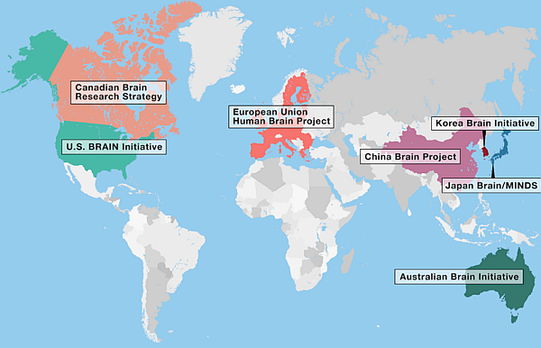
Costs of brain diseases
Total cost of brain disorders in EU in 2010: ~ 800 billion €/year, 45% of the total annual health budget of Europe!
~ 180 millions, or 1/3 of all European citizens with at least one brain disorder during their lifetimes.
Gustavsson et al. (2011). Cost of disorders of the brain in Europe 2010. European Neuropsychopharmacology, 21(10), 718–779. China: > 20% of population (~250 mln) suffering from brain disorders.
Global Brain large initiatives in North America, Europe, China, Korea, Japan and Australia/NZ + a few other countries.
Notes:
https://www.sciencedirect.com/science/article/pii/S0896627314004887 DiLuca and Olesen, 2014
https://onlinelibrary.wiley.com/doi/pdf/10.1111/ejn.13236
https://www.sciencedirect.com/science/article/pii/S0924977X1100215X

Slide 4
Human Brain Project, EU Flagship (2013), and Obama BRAIN Initiative (2013): BRAIN=Brain Research through Advancing Innovative Neurotechnologies.
“Develop new technologies to explore how the brain’s cells and circuits interact … uncovering the complex links between brain function and behavior. Explore how the brain records, processes, uses, stores, and retrieves vast quantities of information. Help bring safe and effective products to patients and consumers.”
Since 2013 numerous exciting developments in neurotechnology and our understanding of the brain have been made by scientists across the globe.

Slide 5
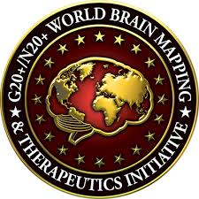
The mission of IEEE Brain is to facilitate cross-disciplinary collaboration and coordination to advance research, standardization and development of technologies in neuroscience to help improve the human condition.
20 IEEE Societies are involved, including: IEEE Computational Intelligence Society; Computer Society; Consumer Electronics Society; Digital Senses Initiative; Robotics and Automation Society; Sensors Council; Signal Processing Society; Society on Social Implications of Technology; Systems, Man, and Cybernetics Society, Int. Neuroethics Society, and a few other societies.
Most these societies are also involved in artificial intelligence.
Satya Nadella (CEO, Microsoft): to celebrate National Disability Employment Awareness Month, I’m sharing examples of how technology can be applied to empower the more than one billion people with disabilities around the world.

Slide 6
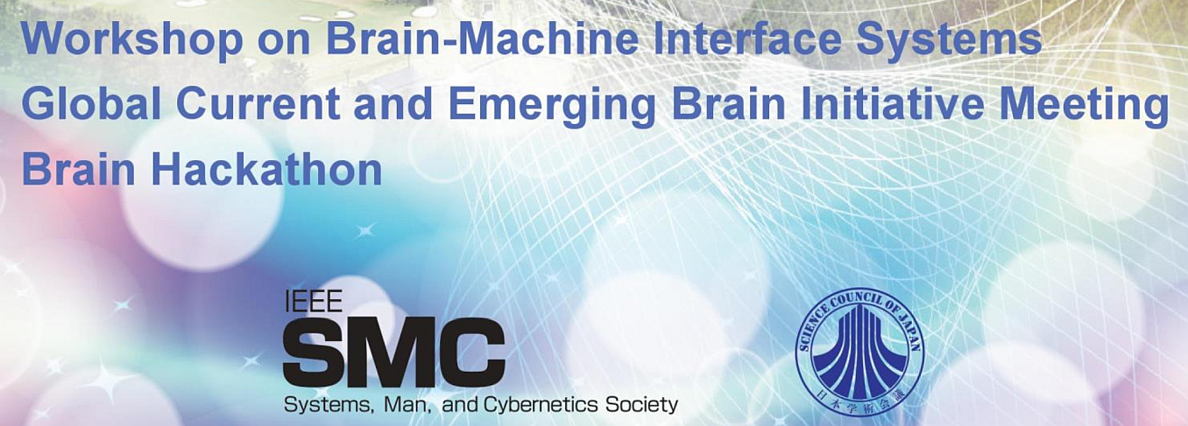
Part of the Brain-Machines Interface Workshop and SMC2018.
The IEEE SMC Society and the IEEE President, James Jefferies, invited us to a special meeting of Global Current and Emerging Brain Initiative leaders and representatives from other groups, working on large-scale multi-year brain projects from Australia, Canada, China, Europe (HBP), Japan, Korea, New Zealand, Poland, Russia, and US (NSF and NIH), with representatives from the IEEE Brain Initiative, International Neuroethics Society, industry, and other stakeholders.

Slide 7
INCF PL
International Neuroinformatics Coordination Facility (INCF) goal: integrate and analyze diverse data across scales, techniques, and species to understand the brain and positively impact the health and well-being of society.
12th INCF Congress on Neuroinformatics and INCF Assembly, Warsaw 9/2019. Neuroimaging, computational neuroscience, artificial intelligence.
Polish INCF Node, established in Warsaw at Nencki Institute, since 2017 at our lab at the Nicolaus Copernicus University in Toruń.
Not only ANN models, but EEG/MEG/fMRI and other data from experiments with animal and human brains.
Neuroscience ⬄ BICA AI

Slide 8
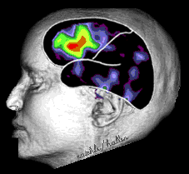
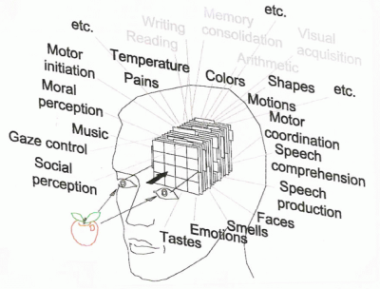
Brains ⬄ Minds
Define mapping S(M)⬄S(B), as in BCI. How mental states arise/influence brain states?
Neurodynamics: bioelectrical activity of the brain, neural activity measured using EEG, MEG, NIRS-OT, PET, fMRI ...
Mental states should be represented in a space with dimensions that measure different aspects of inner experience.
Stream of mental states, thought movement ⬄ trajectories in some psychological spaces.
Two problems: discretization of continuous processes for symbolic models, and lack of good phenomenology – we are not able to describe our mental states.
Duch W. (2019) Mind as a shadow of neurodynamics. Physics of Life Reviews 31: 28

Slide 9
Brain networks: space for mental states

Slide 10
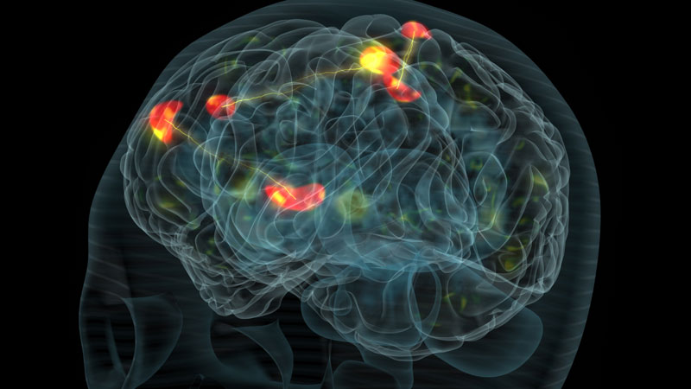
Mental state: strong coherent activation
Many processes go on in parallel, controlling homeostasis and behavior. Most are automatic, hidden from our Self. What goes on in my head?
Various subnetworks compete for access to the highest level of control - consciousness, the winner-takes-most mechanism leaves only the strongest. How to extract stable intentions from such chaos? BCI is never easy.

Slide 11
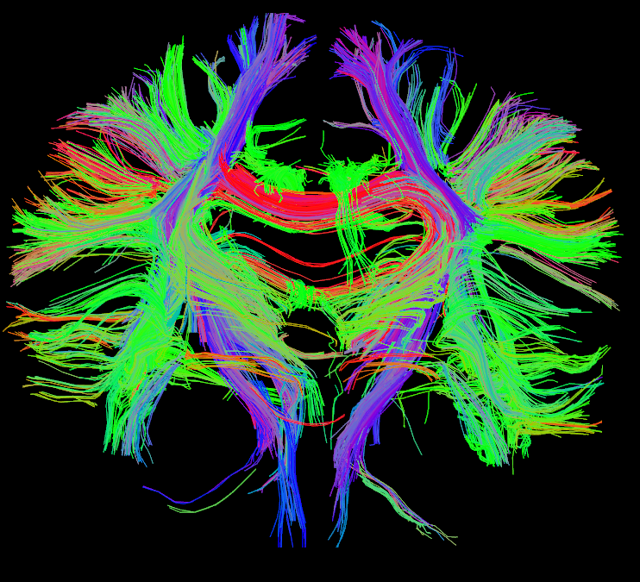
Human connectome and MRI/fMRI
Node definition (parcelation)
Structural connectivity
Functional connectivity
Signal extraction
Correlation
calculation
Graph theory
Whole-brain graph
d=2
Binary matrix
Modularity
Degree
Correlation matrix
Path & efficiency
Clustering
Many toolboxes available for such analysis.
Bullmore & Sporns (2009)
Notes:
Bullmore & Sporns (2009). Complex brain networks: graph theoretical analysis of structural and functional systems.

Slide 12
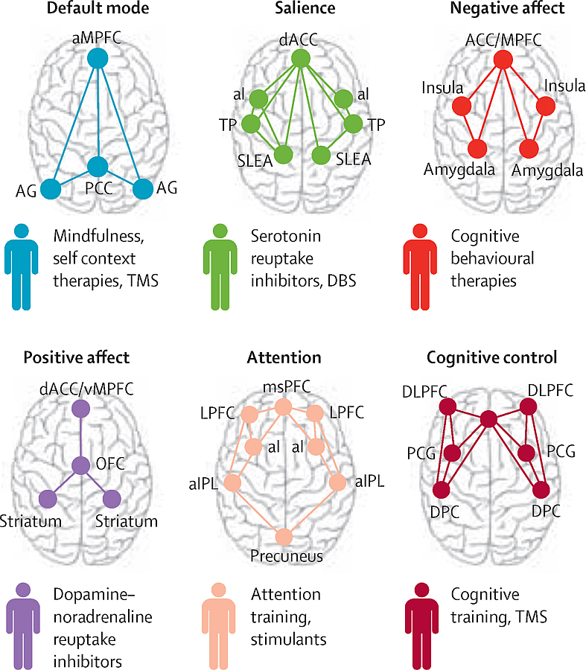
Multi-level phenomics
M. Minsky, Society of mind (1986)
Decompose brain network dynamics into meaningful components of activity related to complex brain functions.
Instead of classification of mental disease by symptoms use Research Domain Criteria (RDoC) matrix based on multi-level neuropsychiatric phenomics describing large brain systems deregulation.
Include influence of genes, molecules, cells, neural networks, physiology, behavior, self-reports on network functions.
Neurodynamics is the key.
Notes:
aMPFC=anterior medial prefrontal cortex. AG=angular gyrus. PCC=posterior cingulate cortex (includes precuneus). dACC=dorsal anterior cingulate cortex. aI=anterior insula. TP=temporal pole. SLEA=sublenticular extended amygdala. ACC/MPFC=dorsal medial prefrontal cortex (includes dorsal ACC and vMPFC, including ventral—subgenual and pregenual—and rostral ACC). msPFC=medial superior prefrontal cortex. LPFC=lateral prefrontal cortex. aIPL=anterior inferior parietal lobule. MPFC=medial prefrontal cortex. vMPFC=ventromedial prefrontal cortex. OFC=orbitofrontal cortex. ACC=anterior cingulate cortex. DLPFC=dorsolateral prefrontal cortex (includes anterior prefrontal cortex and inferior frontal cortex). PCG=precentral gyrus. DPC=dorsal parietal cortex.
Precision psychiatry: a neural circuit taxonomy for depression and anxiety- ClinicalKey. (n.d.). Retrieved May 11, 2018, from https://www-1clinicalkey-1com-1i6jv00h80ab9.han3.uci.umk.pl/#!/content/playContent/1-s2.0-S2215036615005799?returnurl=null&referrer=null

Slide 13
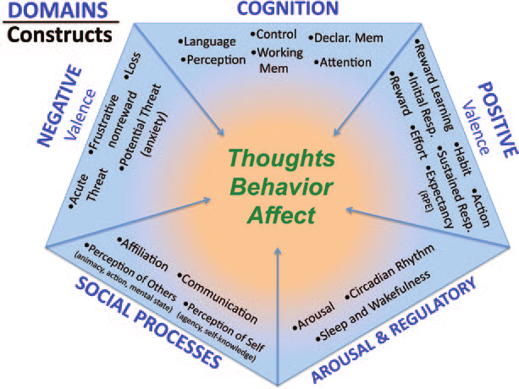
NIMH RDoC Matrix for deregulation of 6 large brain systems.
Sensorimotor domain

Slide 14
Human Enhancement and Optimization of Brain Processes

Slide 15
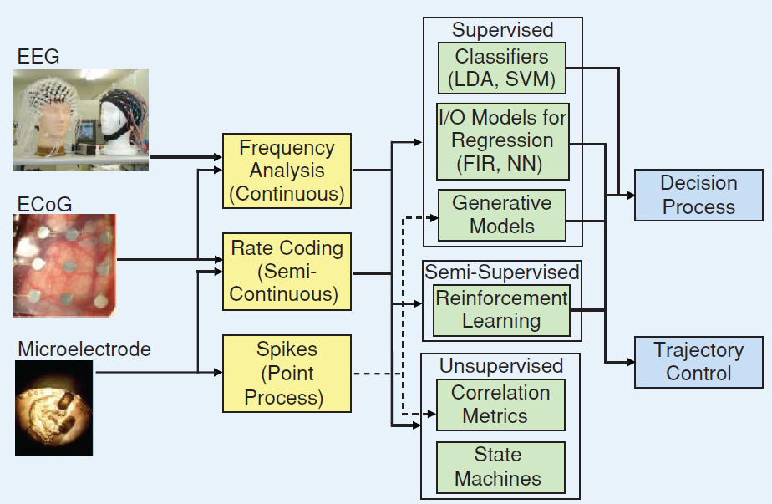
BCI: wire your brain …
Non-invasive, partially invasive and invasive signals carry progressively more information, but are also harder to implement. EEG is still the king!

Slide 16
BCI Applications
Signals: invasive (brain implants), partially invasive (ECoG), and non-invasive.
Notes:
Source: Wolpaw JR, Wolpaw EW. Brain-computer interfaces: something new under the sun. In: Wolpaw JR, Winter Wolpaw E, editors. Brain-computer interfaces: principles and practice. Oxford: Oxford University Press; 2012. p. 3–12

Slide 17
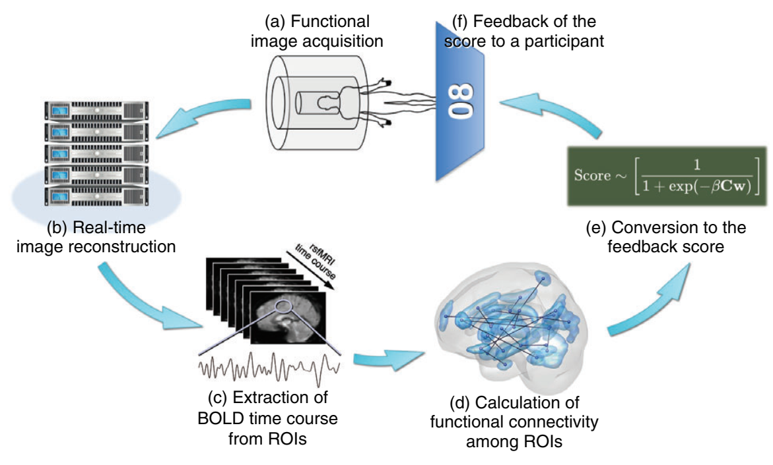
Neurofeedback may repair network?
Megumi F, Yamashita A, Kawato M, Imamizu H. Functional MRI neurofeedback training on connectivity between two regions induces long-lasting changes in intrinsic functional network. Front. Hum. Neurosci. 2015; 9: 160.

Slide 18
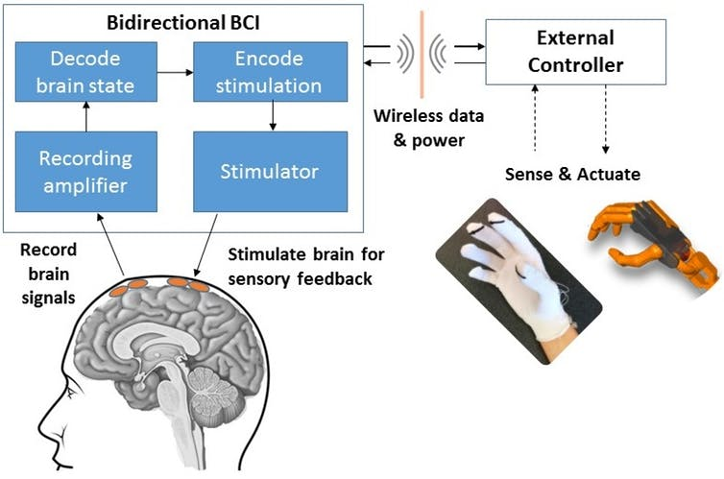
Brain-Computer-Brain Interfaces (BCBI)
Closed loop system with brain stimulation for self-regulation. Body may be replaced by sensory signals in Virtual Reality.
Notes:
A bidirectional brain-computer interface (BBCI) can both record signals from the brain and send information back to the brain through stimulation. Image Credit: Center for Sensorimotor Neural Engineering (CSNE), CC BY-ND

Slide 19
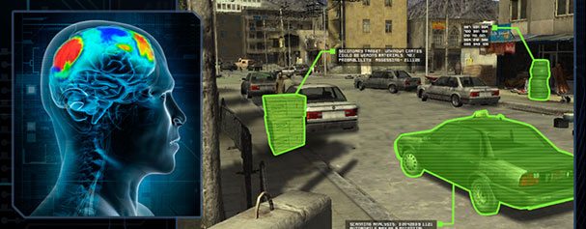
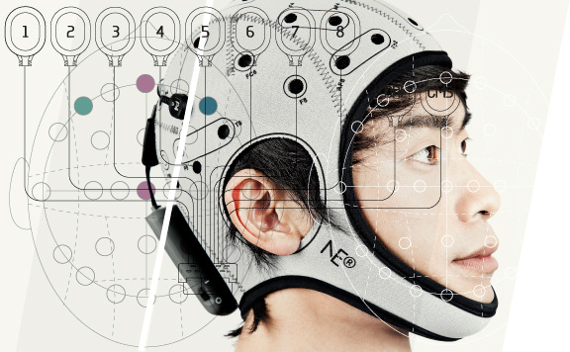
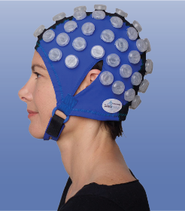
Learning skills
Engagement Skills Trainer (EST) procedures are used by USA army.
Intific Neuro-EST uses EEG analysis and mulit-channel transcranial simulation (HD-DCS) to pre-activate the brain of the novice in areas where the expert brain is active.
Real-life transfer learning …
HD-tDCS may have 100 channels, neurolace and nanowires much more.
Inject microcurrents into the motor cortex …

Slide 20
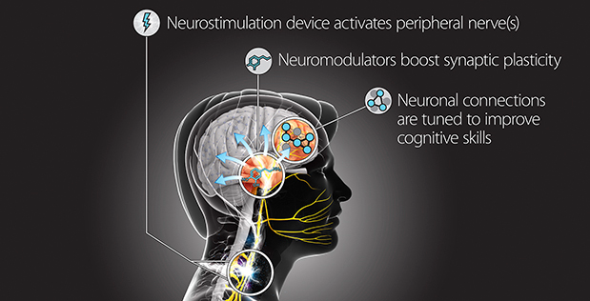
Targeted Neuroplasticity Training
DARPA (2017): Enhance learning of a wide range of cognitive skills, with a goal of reducing the cost and duration of the Defense Department’s extensive training regimen, while improving outcomes. TNT could accelerate learning and reduce the time needed to train foreign language specialists, intelligence analysts, cryptographers, and others.

Slide 21
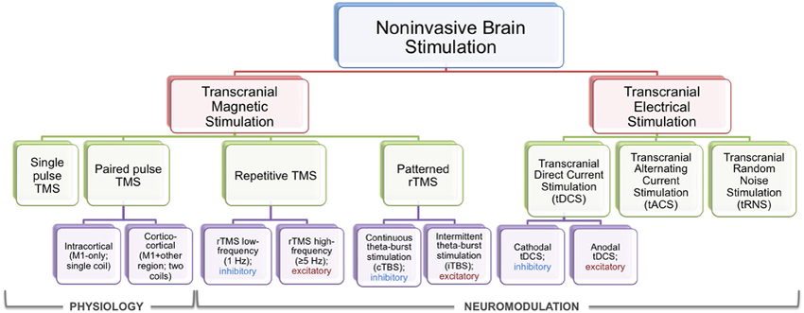
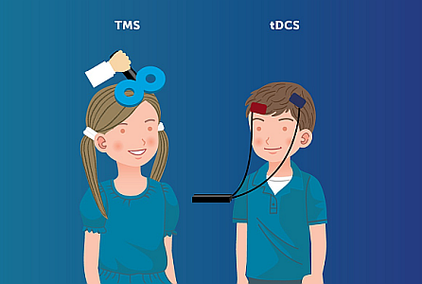
Brain stimulation
ECT – Electroconvulsive Therapy
VNS – Vagus Nerve Stimulation
Ultrasound, laser … stimulation.
Complex techniques? Smartphones are also complex.
Attention? Just stimulate your cortex, no effort is needed!

Slide 22
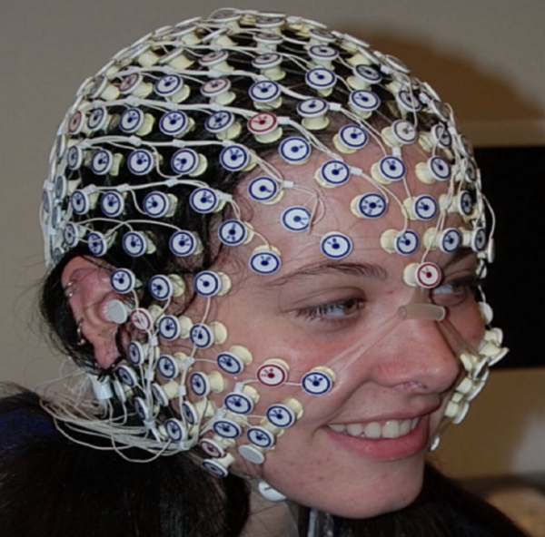
HD EEG/DCS?
EEG electrodes + DCS.
Reading brain states => transforming to common space => duplicating in other brains Applications:
depression, neuro-plasticity, pain, psychosomatic disorders, teaching!
Multielectrode DCS stimulation with 256 electrodes induces changes in the brain increasing neuroplasticity.

Slide 23
Epilepsy
1% of population suffers from epilepsy, if pharmacology does not help neurostimulation based on close loop may help – RNS system is now commercial.
Notes:
https://www.neuropace.com/the-rns-system/#how-it-works

Slide 24
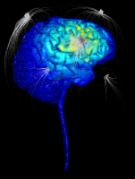
BCBI for learning
Teaching skills by stimulating cortex: microstimulation too low to evoke muscle activation, applied in premotor cortex, instructed specific actions. Mazurek & Schieber (2017). Injecting Instructions into Premotor Cortex.
Eugster et al. (2016). Natural brain-information interfaces: Recommending information by relevance inferred from brain signals. Your brain knows better what is interesting than you do, so use EEG to model search intent while searching, watching or analyzing data.
Externally induced frontoparietal synchronization modulates network dynamics & enhances working memory performance (Violante et al 2017).
Neuroimaging based assessment strategy may provide an objective means of evaluating learning outcomes in the application of Universal Design for Learning (UDL), an educational framework created to guide the development of flexible learning environments that adapt to individual learning differences.

Slide 25
Synchronize PFC/PC
Violante, I.R. et al. Externally induced frontoparietal synchronization modulates network dynamics and enhances working memory performance. ELife, 6 (2017).
Notes:
Violante, I. R., Li, L. M., Carmichael, D. W., Lorenz, R., Leech, R., Hampshire, A., … Sharp, D. J. (2017). Externally induced frontoparietal synchronization modulates network dynamics and enhances working memory performance. ELife, 6, e22001. https://doi.org/10.7554/eLife.22001

Slide 26
Fingerprints of mental activity

Slide 27
Possible form of Brain Fingerprints
How to link patterns of brain activity to active regions/networks, S(M)⬄S(B)
fMRI: BFP is based on V(X,t) voxel intensity of fMRI BOLD signal changes, contrasted between task and reference activity or resting state. EEG: spatial, spatio-temporal, ERP maps/shapes, coherence, various phase synchronization indices.
Spatial/Power: direct localization/reconstruction of sources.
Spatial/Synch: changes in functional graph network structure.
Frequency/Power: ERS/ERD smoothed patterns E(X,t,f).
ERP power maps: spatio-temporal averaged energy distributions.
EEG decomposition into components: ICA, CCA, tensor, RP ...
EEG microstates, sequences & transitions, dynamics in ROI space.
Spectral fingerprinting (MEG, EEG), power distributions.
Model-based: The Virtual Brain, integrating EEG/neuroimaging data.
Neuroplastic changes of connectomes and functional connections as results of training for optimization of brain processes.

Slide 28
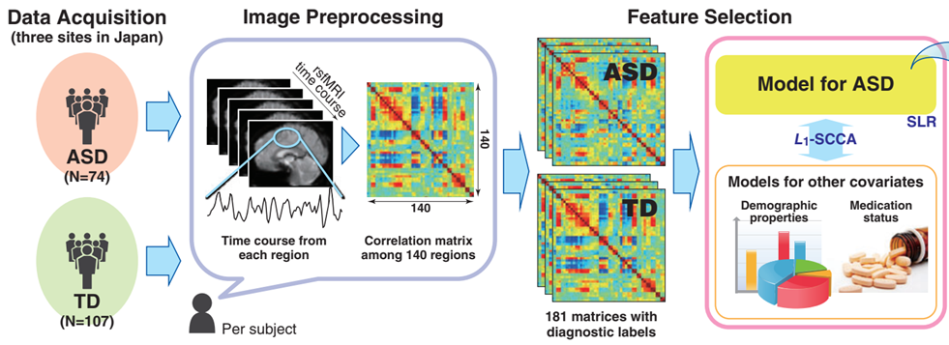
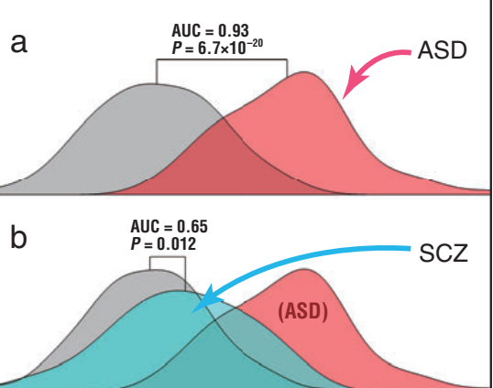
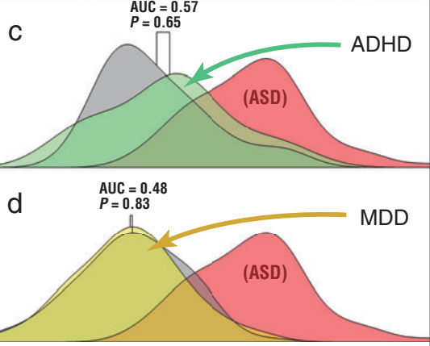
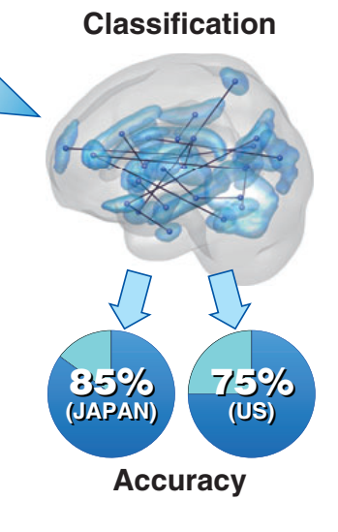
Biomarkers from neuroimaging
N. Yahata et al, Psychiatry and Clinical Neurosciences 2017: 71
Notes:
Figure 2 | The 16 FCs identified for the ASD/TD classifier. (a–c) The 16 FCs viewed from (a) top, (b) posterior and (c) left. The inset displays all 9,730 FCs. The 29 terminal regions connected by the 16 FCs were numbered as follows: in the frontal lobe, the superior (1), middle (2), inferior (3, left; 4–7, right) gyri and rectus (8); in the temporal lobe, the superior (9), middle (10), inferior (11), parahippocampal (12) and fusiform (13) gyri; in the parietal lobe, the superior parietal lobule (14) and the postcentral gyrus (15); in the occipital lobe, the middle occipital gyrus (16), cuneus (17, left; 18, right) and the calcarine fissure (19); in the limbic system, the anterior (20), middle (21–22), posterior (23) cingulate gyri and amygdala (24); in the basal ganglia, the caudate (25, left; 26, right), pallidum (27), thalamus (28); and cerebellum (29).

Slide 29
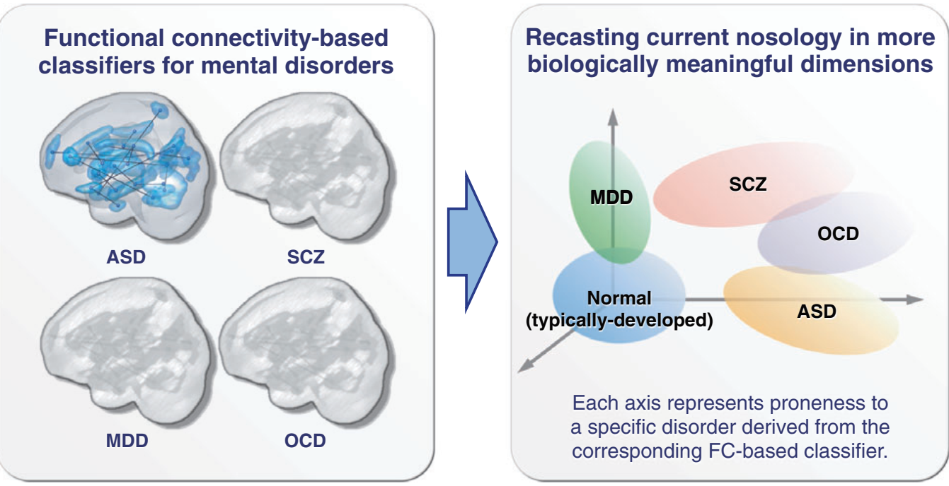
Biomarkers of mental disorders
MDD, deep depression, SCZ, schizophrenia, OCD, obsessive-compulsive disorder, ASD autism spectrum disorder. fMRI biomarkers allow for objective diagnosis. N. Yahata et al, Psychiatry & Clinical Neurosciences 2017; 71: 215–237
Notes:
Figure 2 | The 16 FCs identified for the ASD/TD classifier. (a–c) The 16 FCs viewed from (a) top, (b) posterior and (c) left. The inset displays all 9,730 FCs. The 29 terminal regions connected by the 16 FCs were numbered as follows: in the frontal lobe, the superior (1), middle (2), inferior (3, left; 4–7, right) gyri and rectus (8); in the temporal lobe, the superior (9), middle (10), inferior (11), parahippocampal (12) and fusiform (13) gyri; in the parietal lobe, the superior parietal lobule (14) and the postcentral gyrus (15); in the occipital lobe, the middle occipital gyrus (16), cuneus (17, left; 18, right) and the calcarine fissure (19); in the limbic system, the anterior (20), middle (21–22), posterior (23) cingulate gyri and amygdala (24); in the basal ganglia, the caudate (25, left; 26, right), pallidum (27), thalamus (28); and cerebellum (29).

Slide 30
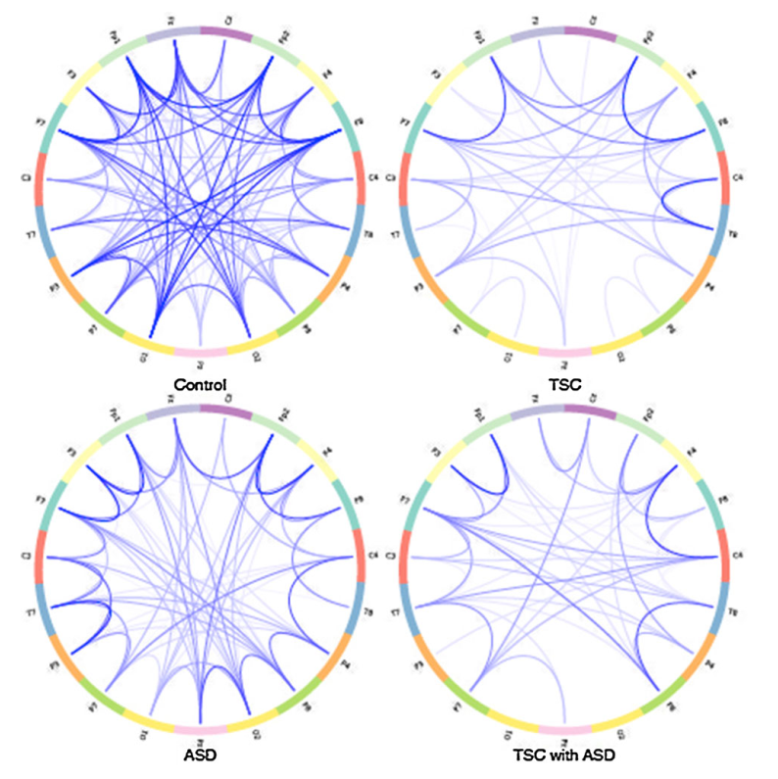
ASD: pathological connections
Comparison of connections for patients with ASD (autism spectrum), TSC (Tuberous Sclerosis), and ASD+TSC.
Coherence between electrodes. Weak or missing connections between distant regions prevent ASD/TSC patients from solving more demanding cognitive tasks.
Network analysis becomes very useful for diagnosis of changes due to the disease and learning; correct your networks!
J.F. Glazebrook, R. Wallace, Pathologies in functional connectivity, feedback control and robustness. Cogn Process (2015) 16:1–16
Notes:
Tuberous Sclerosis stwardnienie guzowate

Slide 31
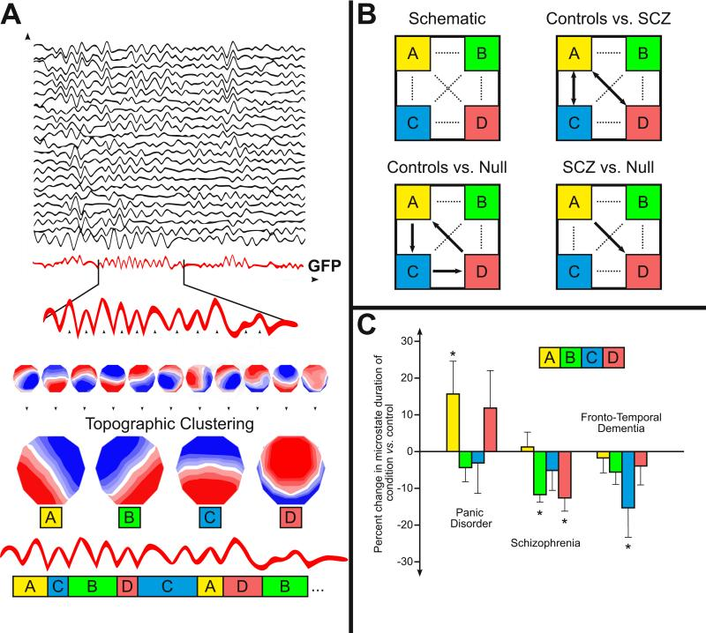
Microstates
Lehmann et al. EEG microstate duration and syntax in acute, medication-naïve, first-episode schizophrenia. Psychiatry Research Neuroimaging, 2005 Khanna et al. Microstates in Resting-State EEG. Neuroscience and Biobehavioral Reviews, 2015
4-7 states 60-150 ms Symbolic dynamics.
Notes:
(A) An illustration of the method of microstate clustering and analysis. Multichannel EEG signal in the frequency band of interest (usually 8-12 Hz, but sometimes wider) is used to calculate the GFP curve (drawn in red), which gives a measure of the instantaneous field strength over time. Peaks of the GFP curve represent instances of highest field strength and largest topographic SNR. The electric potentials of all electrodes at moments of local maxima of the GFP curve are plotted to generate topographic maps of the electrode array. These maps are submitted to a clustering algorithm, which groups the submitted maps into a small set of clusters based on topographic similarity. Most studies of resting-state EEG microstates find the same set of four cluster maps (labeled A-D) that are the “microstate maps.” In the final step, the original maps at maxima of the GFP curve are assigned a label based on the microstate map they best correlate to. A single microstate map remains dominant for 80-120ms before rapidly transitioning to a different map. The multichannel EEG signal is described as a series of alternating microstates. (B) Schematic of transitions between microstates and an example of its impairment in schizophrenia (SCZ). Schematic illustration and data from (Lehmann et al., 2005). The pattern of transitions between microstates is nonrandom and changes significantly in schizophrenia. The dotted paths of the schematic square represent all of the possible transitions between the microstates A-D. When compared against the null hypothesis that transitions among A-D are random, observed transition frequencies are significantly nonrandom at p<0.005 (Lehmann et al., 2005). The arrows in controls vs. null and patients vs. null show the nonrandom transition directionalities. The double-headed arrows in controls vs. patients show significant (p<0.05) differences in transition probabilities between controls and patients with schizophrenia. (C) The average duration of certain microstates are altered in various conditions, including panic disorder (data adapted from Kikuchi et al., 2011), acute schizophrenia (data adapted from Lehmann et al., 2005), and fronto-temporal dementia (data adapted from Nishida et al., 2013). An asterisk indicates significance at p<0.05.

Slide 32
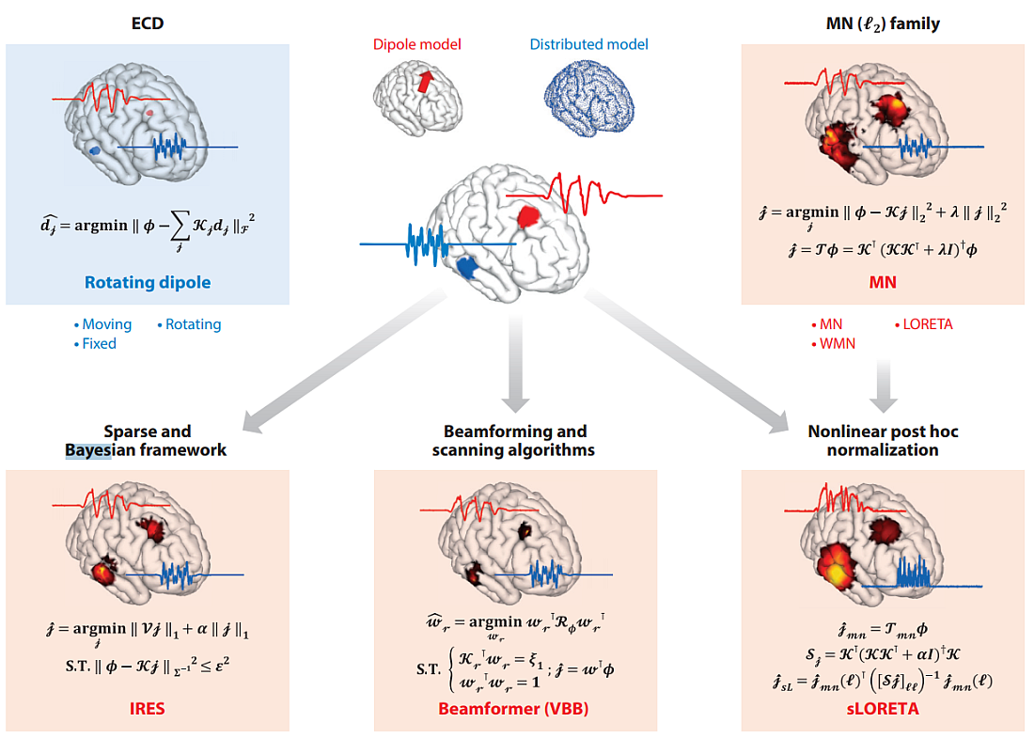
EEG localization and reconstruction
He et al. Rev. Biomed Eng (2018)
Notes:
He, B., Sohrabpour, A., Brown, E., & Liu, Z. (2018). Electrophysiological Source Imaging: A Noninvasive Window to Brain Dynamics. Annual Review of Biomedical Engineering, 20(1), 171–196. Different classes and families of source imaging algorithms are depicted. In the center, an underlying brain activity with two separate sources and the corresponding time course of the activity are simulated; the forward problem is solved, and the scalp potential distribution is calculated (simulated EEG). The solution of the dipole localization method for the given example is depicted on the top left. The rest of the figure shows the major families of inverse algorithms, and bulleted lists show some of the well-known algorithms in each family as examples (the lists are by no means exhaustive). For each case, the algorithm used to solve and produce the result is shown in bold red font under the result. The mathematical formulation for the algorithm is provided for each solution. The lead-field matrix (a transformation from the current dipole distribution to the scalp potential) is denoted by 𝒦, the scalp potential as φ, the current density distribution as 𝒿, and the dipole moment as 𝒹𝒿 (the lead-field entries corresponding to 𝒹𝒿 are denoted by 𝒦𝒿). The inverse imaging operator (for the MN family) is denoted by 𝒯, and λ and α are regularization parameters. In the beamforming family, the data covariance is denoted by ℛφ and the spatial filter weights by 𝓌𝓇. For the IRES algorithm, 𝒱 is the discrete gradient operator, is the estimated noise covariance, and ε is the estimated noise power. Abbreviations: DICS, dynamic imaging of coherent sources; dSPM, dynamic statistical parametric mapping; ECD, equivalent current dipoles; EEG, electroencephalography; ESI, electrophysiological source imaging; FINE, first-principle vector; FOCUSS, focal undetermined system solution; IRES, iteratively reweighting edge sparsity; LCMV, linearly constrained minimum variance; LORETA, low-resolution electromagnetic tomography; MN, minimum norm; MUSIC, multiple classification algorithm; SBL, sparse Bayesian learning; sLORETA, standardized LORETA; VB-SSI, variation-based sparse source imaging; VBB, vector-based beamformer; WMN, weighted MN.

Slide 33
SupFunSim
SupFunSim: our library/Matlab /tollbox, direct models for EEG/MEG, on GitHub.
Provides many spatial filters for reconstruction of EEG sources: linearly constrained minimum-variance (LCMV), eigenspace LCMV, nulling (NL), minimum-variance pseudo-unbiased reduced-rank (MV-PURE) …
Source-level directed connectivity analysis: partial directed coherence (PDC), directed transfer function (DTF) measures.
Works with FieldTrip EEG/ MEG software. Modular, object-oriented, using Jupyter notes, allowing for comments and equations in LaTex.
Rykaczewski, K., Nikadon, J., Duch, W., & Piotrowski, T. (2020). Neuroinformatics.
Notes:
https://github.com/IS-UMK/supFunSim.git
Filtry przestrzenne, liczba warstw w modelu głowy, liczba elektrod.
Rykaczewski, K., Nikadon, J., Duch, W., & Piotrowski, T. (2019). BioRxiv, 618694

Slide 34
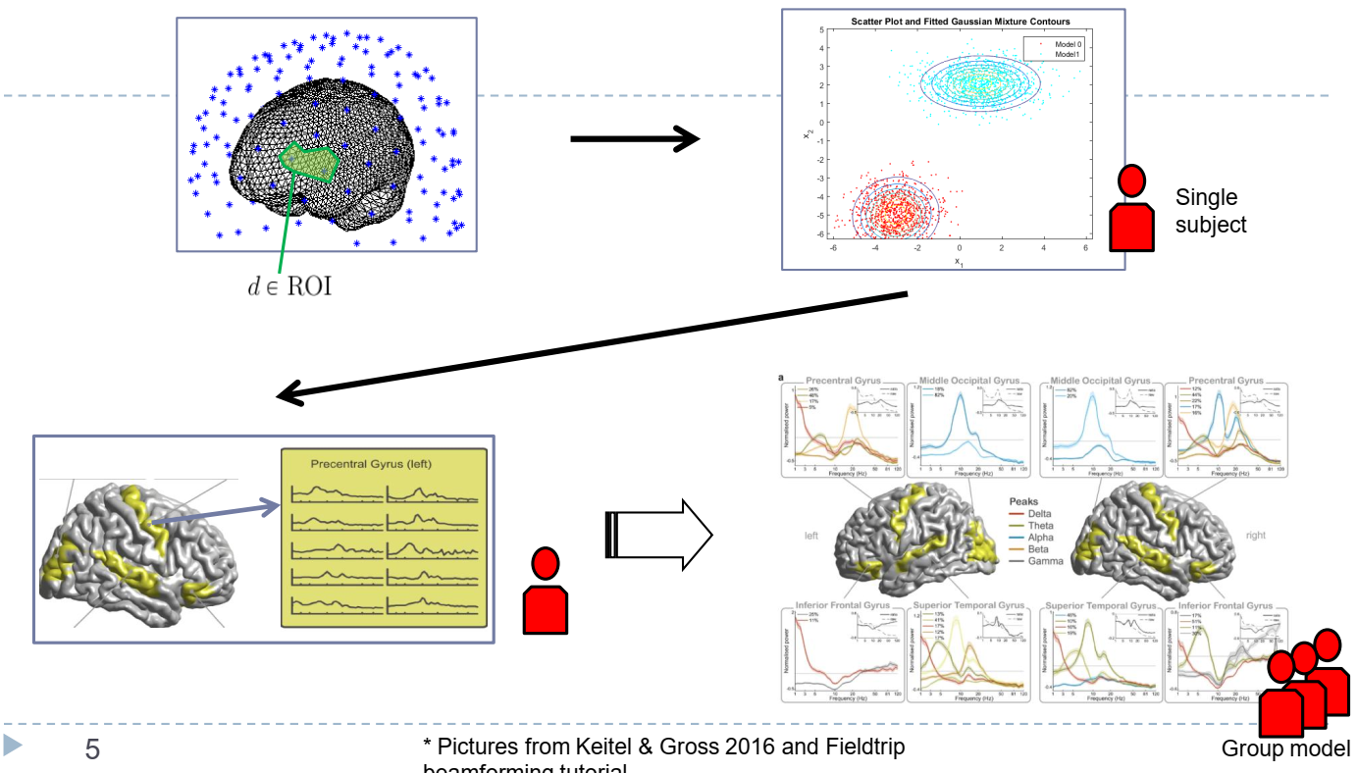
Spectral fingerprints
A. Keitel i J. Gross, „Individual human brain areas can be identified from their characteristic spectral activation fingerprints”, PLoS Biol 14(6), e1002498, 2016
Notes:
Liu, Q., Farahibozorg, S., Porcaro, C., Wenderoth, N., & Mantini, D. (2017). Detecting large-scale networks in the human brain using high-density electroencephalography. Human Brain Mapping, 38(9), 4631–4643.
… reconstruct power envelopes of oscillatory activity in source space from each hdEEG dataset.

Slide 35
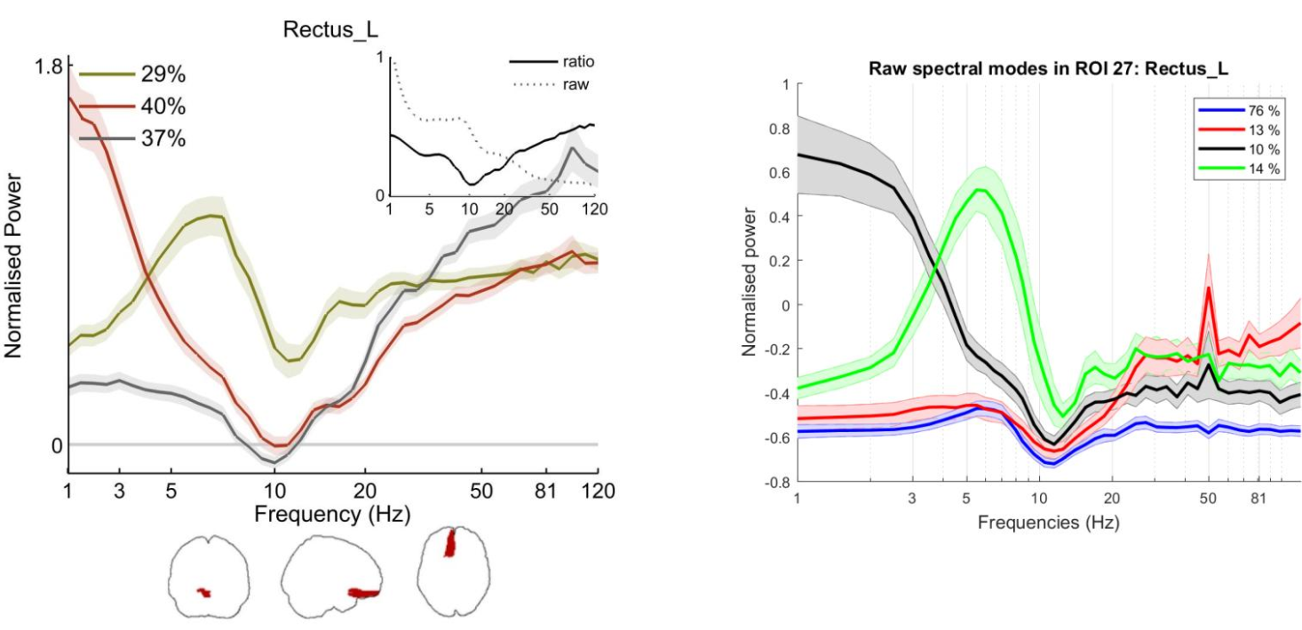
Spectral fingerprints
A. Keitel i J. Gross, „Individual human brain areas can be identified from their characteristic spectral activation fingerprints”, PLoS Biol 14, e1002498, 2016
Notes:
Liu, Q., Farahibozorg, S., Porcaro, C., Wenderoth, N., & Mantini, D. (2017). Detecting large-scale networks in the human brain using high-density electroencephalography. Human Brain Mapping, 38(9), 4631–4643.
… reconstruct power envelopes of oscillatory activity in source space from each hdEEG dataset.

Slide 36
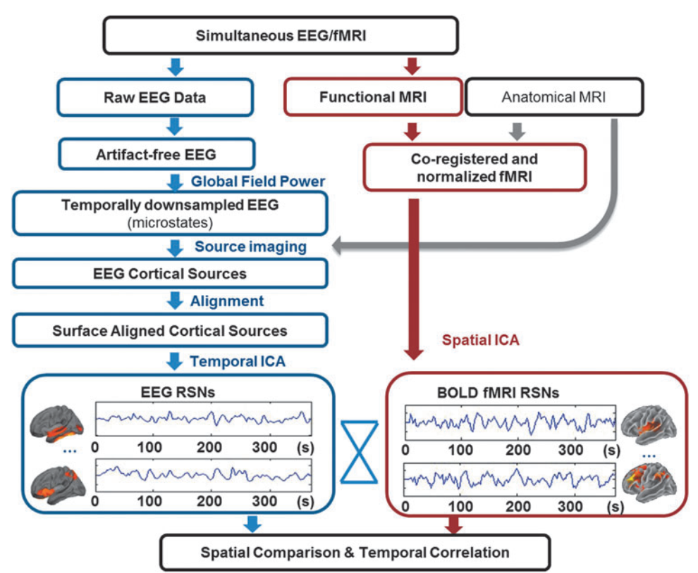
Yuan .. Bodurka, 2015
Notes:
Yuan, H., Ding, L., Zhu, M., Zotev, V., Phillips, R., & Bodurka, J. (2015). Reconstructing Large-Scale Brain Resting-State Networks from High-Resolution EEG: Spatial and Temporal Comparisons with fMRI. Brain Connectivity, 6(2), 122–135. https://doi.org/10.1089/brain.2014.0336

Slide 37
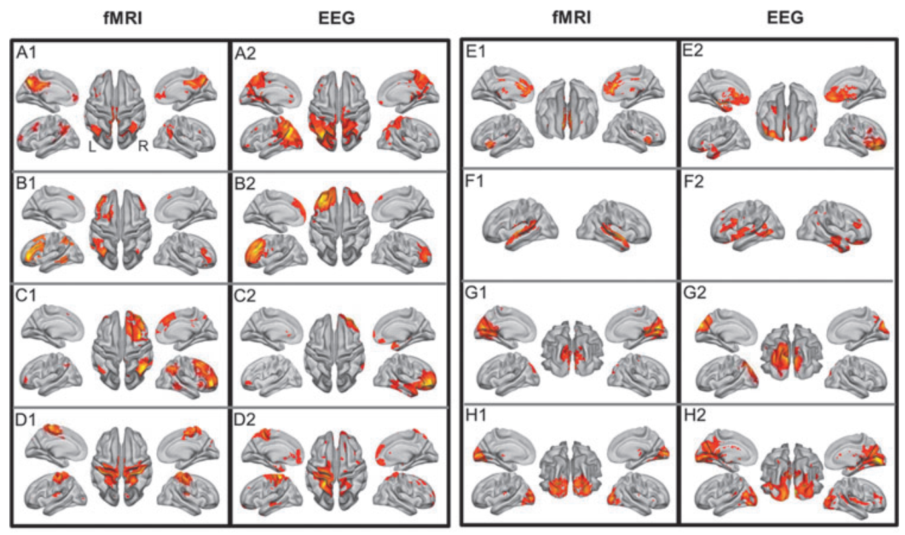
8 large networks from BOLD-EEG
DMN, FP (frontoparietal)-left, right, sensorimotor, ex, control, auditory, visual (medial), (H) visual (lateral). Yuan … Bodurka (2015)
Notes:
Eight well-matched pairs of blood oxygenation level-dependent (BOLD)-fMRI-derived (numerical label 1) and EEG-derived (numerical label 2) RSNs. (A) Default model network (DMN), (B) frontoparietal (left), (C) frontoparietal (right), (D) sensorimotor, (E) executive control, (F) auditory, (G) visual (medial), (H) visual (lateral).
All maps are shown on the partially inflated cortical surface, with sulci indicated by darker gray color and gyri by lighter gray color. Five informative views are displayed. The networks were paired automatically by using spatial cross-correlation. All spatial maps were thresholded at jzj =3. Yuan, H., Ding, L., Zhu, M., Zotev, V., Phillips, R., & Bodurka, J. (2015). Reconstructing Large-Scale Brain Resting-State Networks from High-Resolution EEG: Spatial and Temporal Comparisons with fMRI. Brain Connectivity, 6(2), 122–135. https://doi.org/10.1089/brain.2014.0336

Slide 38
Dynamic functional brain networks

Slide 39
EEG early ASD detection
Bosl, W. J., Tager-Flusberg, H., & Nelson, C. A. (2018). EEG Analytics for Early Detection of Autism Spectrum Disorder: A data-driven approach. Scientific Reports, 8(1), 6828.
EEG of 3 to 36-month old babies, 19 electrodes selected from 64 or 128.
Daubechies (DB4) wavelets transform EEG signal into 6 bands.
7 features from Recurrence Quantitative Analysis (RQA): RP entropy, recurrence rate, laminarity, repetition, max/mean line length, trapping time.
In addition sample entropy and Detrended Fluctuation Analysis was used.
Nonlinear features were computed from EEG signals and used as input to statistical learning methods. Prediction of the clinical diagnostic outcome of ASD or not ASD was highly accurate.
SVM classification with 9 features gave high specificity and sensitivity, exceeding 95% at some ages. Prediction using only EEG data taken as early as 3 months of age was strongly correlated with the actual measured scores.
Notes:
Using the wavelet transform, each sensor signal is decomposed into six power-of-two frequency bands that are approximately equal to the commonly used defnitions of delta, theta, alpha, beta, gamma, and gamma + bands used for EEG analysis. Te specifc sofware used for the wavelet transform is publicly available, along with instructions and python code, at: https://pywavelets.readthedocs.io. Table 2 shows the six frequency bands used in this study.

Slide 40
EEG non-linear features
Features: not only structure, but also dynamics. Nonlinear invariant measures of a time series and their physical interpretation, recurrence quantification analysis (RQA).
For example:
Sample Entropy (SampE)
Entropy derived from recurrence plot (L_entr).
Recurrence rate (RR), probability of recurrence.
Determinism (DET), repeating patterns in the system.
Laminarity (LAM), frequency of transitions between states.
Trapping time (TT), time in a given state.

Slide 41
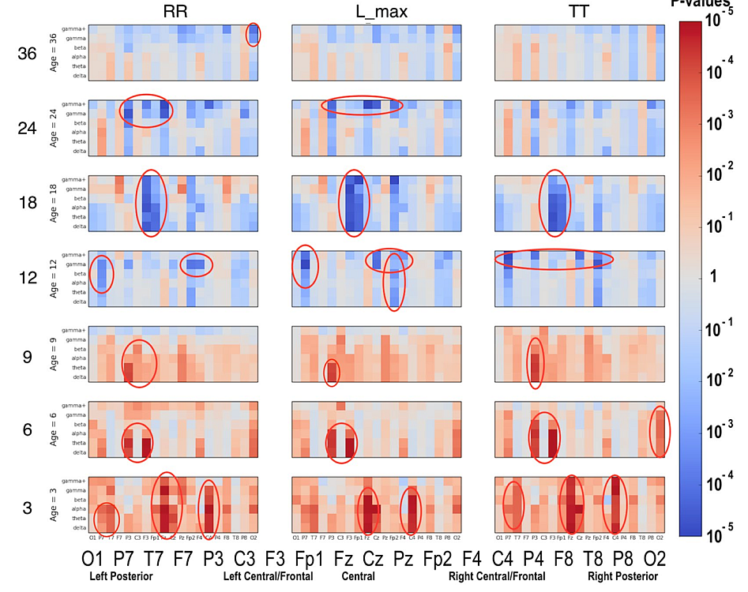
ASD vs Low Risk Healthy
RR = recurrence rate
L_max = max line length, related to Lyapunov exponent
TT = trapping time
Notes:
Using the wavelet transform, each sensor signal is decomposed into six power-of-two frequency bands that are approximately equal to the commonly used defnitions of delta, theta, alpha, beta, gamma, and gamma + bands used for EEG analysis. Te specifc sofware used for the wavelet transform is publicly available, along with instructions and python code, at: https://pywavelets.readthedocs.io. Table 2 shows the six frequency bands used in this study.

Slide 42
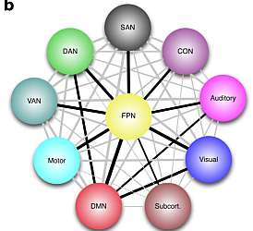
Reorganization of brain nets
Global Neuronal Workspace Theory (Deahene et al. 1998): brain processes underlying effortful tasks require:
Specialized modular processors: perceptual, motor, memory, attentional;
global workspace for activation patterns composed of distributed and heavily interconnected neurons with long-range axons.
Workspace neurons are mobilized in effortful tasks for which the specialized processors (Kahneman’s System 1) do not suffice (System 2).
Can the whole-brain network properties change during performance?
Do modularity, path length, global, local efficiency and other network measures dependent on the cognitive load?
Finc K, Bonna K, Lewandowska M, Wolak T, Nikadon J, Dreszer J, Duch W, Kühn, S. (2017) Transition of the functional brain network related to increasing cognitive demands. Human Brain Mapping, 38(7), 3659–3674.
Finc K, Bonna K, He X, Lydon-Staley D, Kühn S, Duch W, Bassett D.S. (2020) Dynamic reconfiguration of functional brain network during working memory training. Nature Communications 11, 2435, 2020
Notes:
Characteristic path length (l) is a measure of the mean number of links that must be traversed in order to travel between any two nodes in the network.
Clustering coefficient (C) is a measure of the average proportion of a node’s nearest neighbors that are also connected to each other.

Slide 43
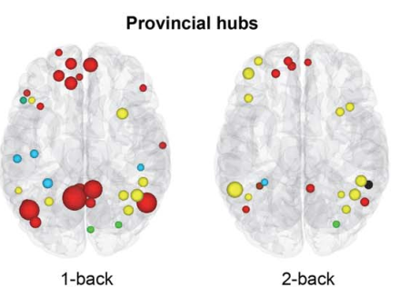
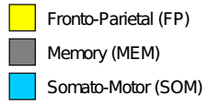
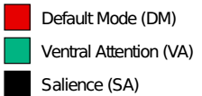
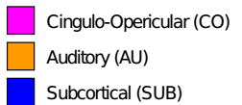
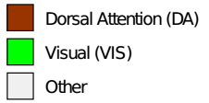
Brain modules and cognitive processes
Simple and more difficult tasks, requiring the whole-brain network reorganization.
Left: 1-back local hubs
Right: 2-back local hubs
Average over 35 participants.
Dynamical change of the landscape of attractors, depending on the cognitive load. Less local (especially in DMN), more global binding (especially in PFC).
K. Finc et al, HBM (2017).

Slide 44
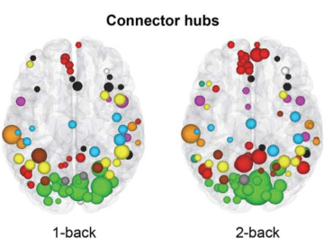
Brain modules and cognitive processes
Simple and more difficult tasks, requiring the whole-brain network reorganization.
Left: 1-back connector hubs
Right: 2-back connector hubs
Average over 35 participants.
Dynamical change of the landscape of attractors, depending on the cognitive load – System 2 (Khaneman). DMN areas engaged in global binding!
K. Finc et al, HBM (2017).

Slide 45
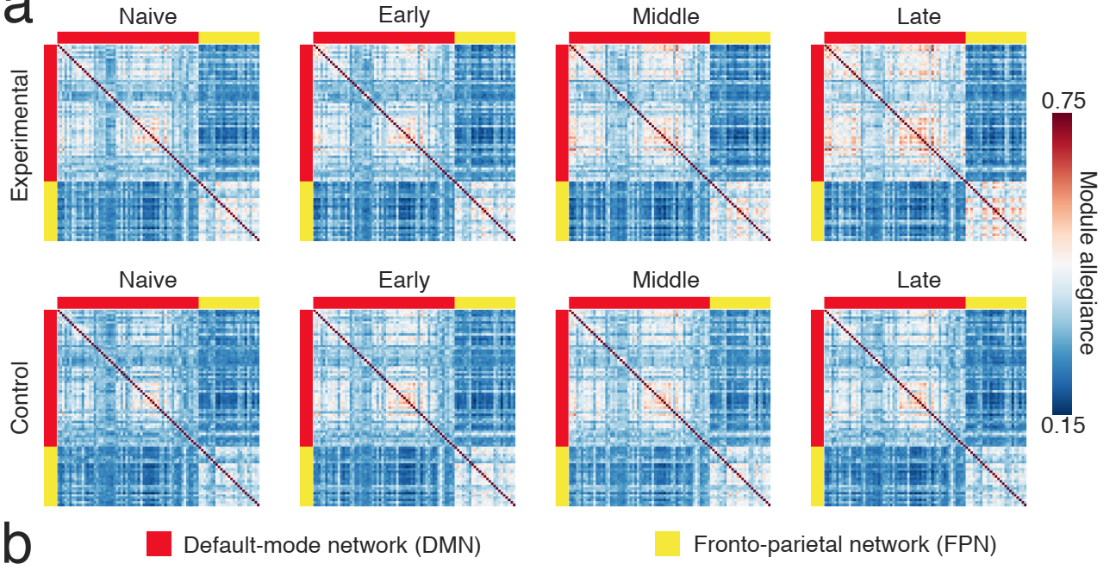
Working memory training
6-week training, dual n-back task, changes in module allegiance of fronto-parietal and default-mode networks. Each matrix element represents the probability that the pair of nodes is assigned to the same community.
Segregation of task-relevant DMN and FPN regions is a result of training and complex task automation.
Notes:
Dynamic reconfiguration of functional brain network during working memory training Karolina Finc1, Kamil Bonna1,2, Xiaosong He3, David Lydon-Staley3, Simone K¨uhn4,5, W lodzis law Duch1,2, and Danielle S. Bassett

Slide 46
Simulations of brain networks

Slide 47
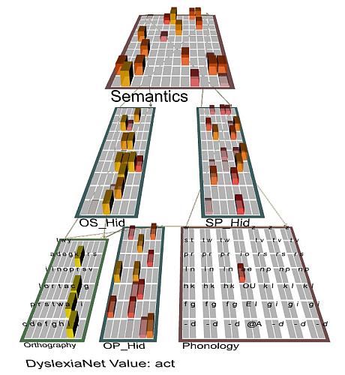
Model of reading & dyslexia
Emergent neural simulator:
Aisa, B., Mingus, B., and O'Reilly, R. The emergent neural modeling system. Neural Networks, 21, 1045, 2008.
3-layer model of reading:
orthography, phonology, semantics, or distribution of activity over 140 microfeatures defining concepts.
In the brain: microfeature=subnetwork. Hidden layers OS/OP/SP_Hid in between.
Learning: mapping one of the 3 layers to the other two.
Fluctuations around final configuration = attractors representing concepts.
How to see properties of their basins, their relations? Model in Genesis: more detailed neuron description.

Slide 48
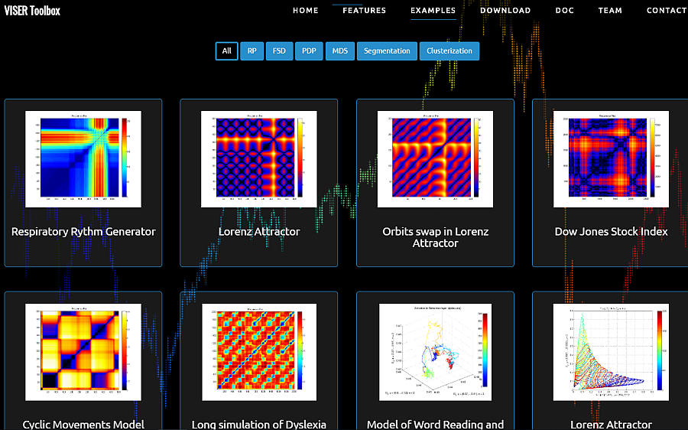
Viser toolbox
Viser toolbox (Dobosz, Duch) contains many techniques to visualize neurodynamics.

Slide 49
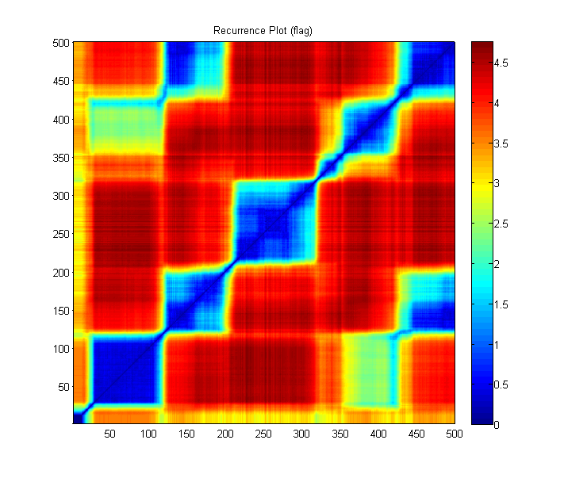
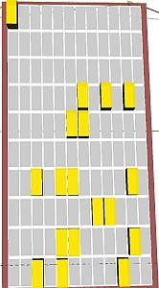
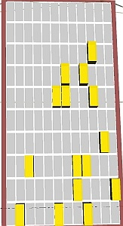
rope
Transitions to new patterns that share some active units (microfeatures) shown in recurrence plots.
flag

Slide 50
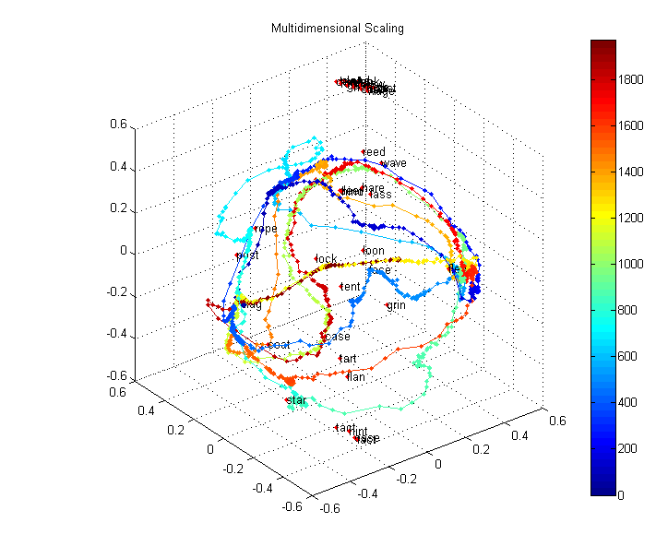
Trajectory visualization
Recurrence plots and MDS/FSD/SNE visualization of trajectories of the brain activity. Here data from 140-dim semantic layer activity during spontaneous associations in the 40-words microdomain, starting with the word “flag”. Our toolbox: http://fizyka.umk.pl/~kdobosz/visertoolbox/

Slide 51
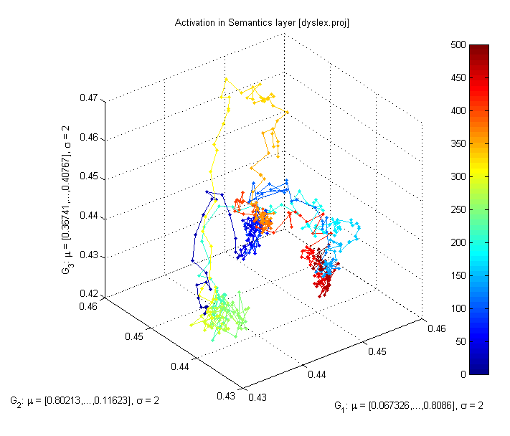
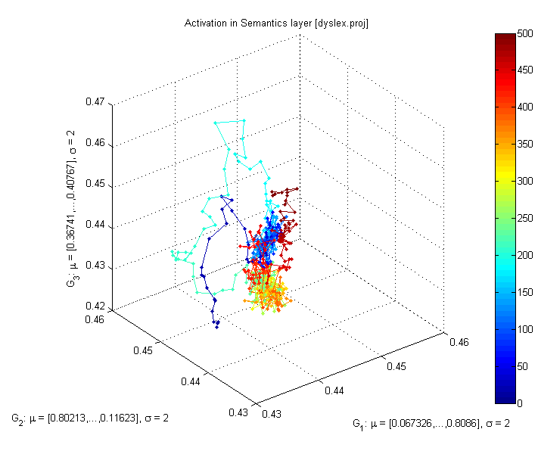
Typical Development vs. Autism
All plots for the flag word, different values of b_inc_dt parameter in the accommodation mechanism. b_inc_dt = 0.01 & b_inc_dt = 0.005
b_inc_dt = time constant for increases in intracellular calcium building up slowly as a function of activation, controls voltage-dependent leak channels.
http://kdobosz.wikidot.com/dyslexia-accommodation-parameters

Slide 52
Typical Development vs ADHD
All plots for the flag word, different values of b_inc_dt parameter in the accommodation mechanism. b_inc_dt = 0.01 & b_inc_dt = 0.02.
b_inc_dt = time constant for increases in intracellular calcium which builds up slowly as a function of activation.
http://kdobosz.wikidot.com/dyslexia-accommodation-parameters

Slide 53
Rapid stimulation in HF ASD
High functioning ASD case (HFA): normal speed of presentation fast presentation long dwelling times enforced quick resynchronization more internal stimuli.

Slide 54
Rapid stimulation in deep autism
Normal speed fast presentation skipping some words, more internal states
no associations some associations arise

Slide 55
Neuromodulation
Cochlear implants are common, but deeper implants that stimulate or even replace some brain structures start to appear, not only for deficits at the level of perception, but to regulate neural processes.

Slide 56
Why neuromodulation works?
Neurorehabilitation: many successes but mechanism is unknown.
Hypothesis 1: changing the activation thresholds of neurons (sensitization and inhibition) changes the way brain networks work.
Hypothesis 2: neuromodulation leads to changes in cardiovascular coupling to neurons, improving blood flow in microvessels.
This can be tested with non-invasive transorbital Alternating Current micro-stimulation device (hACS), used in Magdeburg and Berlin clinics.
Sabel (2018) Restoring Low Vision. Amazon, 251 pp.
We need to show how to optimize parameters of neuromodulation to increase flow of visual information in the brain.

Slide 57
Conclusions
Neurocognitive technologies are used to diagnose, repair and optimize brain processes, helping in neurorehabilitation, pain management, conscious control of brain states. Neuroprostheses for sensory systems and limb control facilitate enhancement of human cognition and activity. This is much safer approach than genetic manipulation.
Mental states – such as motor intentions, plans, images, inner voices – result from brain states that can be measured and interpreted.
Influence of molecular/genetic levels on the brain may be understood indirectly, via changes in neurodynamics, using analysis of brain signals and computer simulations. This is the key to understanding mental states.
The future belongs to cyborgs!

Slide 58
My group of neuro-cog-fanatics

Slide 59
Thank you for synchronizing your neurons!
Our Center of Excellence in Neuroinformatics has open positions for PhD students, postdocs and visiting profs!
Info is on my webpage.
Google: Wlodek Duch => talks, papers, lectures, Flipboard …

